Slide 1
Introduction to Software Development
Week 5 Day 3
Led by: Emily Crose
for
Oakland University

Slide 2
Previous Session Review

Slide 3

Questions from last session?

Slide 4
Terms to listen for
Scoping
Determining tasks relevant to the goals of the project
Scope Creep
Slow, unexpected widening of the initial scope
FUD
Fear, Uncertainty and Doubt
Tech Debt
Technology that we are responsible to maintain

Slide 5



Getting Started
Notes:
We all know that one of the hardest parts of working on a project is getting started. We’ve talked about the SDLC and overviewed how we get from point A to point B using the SDLC and the devops paradigm as connective tissue.

Slide 6
Research Phase
Current State
Business Need
Possible Solutions

Slide 7
Current State
Why are we having a problem now?
Foreseeable or unforeseeable?
Lessons learned?
What about our current technology is lacking?
What technology do we have in this space now, and how is it working?
Complementary solution?
Complete rebuild of the space?

Slide 8
Reflecting On Our Organization
Is this the first time we’re adopting the SDLC?
Is our org healthy?
Do we need to make any changes before starting?
How well is our documentation and organization of existing and legacy projects?
Notes:
It might seem like a needless exercise, but starting a new programming project involving the SDLC is a good opportunity to reflect on the state of our organization, and how it got to the place it is in. Is our organization in a good place?

Slide 9
Researching Our Technology
Are we happy with the technology choices we’ve made so far?
Can we fold in any lessons learned from our past decisions?
What’s the state of our integrations?
Notes:
This technology becomes the base working environment for the new technology we will be adding to the space. Can we use any lessons learned for the next phase of our programming projects? And what about the integrations that our new projects will depend on in the shared space with our existing projects?

Slide 10
Business Need
What business problems is this app going to solve?
How will this software solve that problem exactly?
Will any business or revenue needs impact the design the application’s operation?
If so, how?
Do we need to integrate with other companies?

Slide 11
Possible Solutions
You don’t need to do this alone!
Technology consultants
Do complete research!
Notes:
You don’t need to do this on your own! You can go to a consultant at this stage and get advice on which current technologies might suit the requirements best. In any case, you will want to do the best research you can. You’ll only get once chance to easily start this project.

Slide 12
Compare Chart
Criteria | Product 1 | Product 2 | Product 3
Cost to license | xxx | x | xx
Cost to implement | x | xxx | xx
Ease of use | x | xx | xxx
Features | xx | x | xxx
Ongoing Costs | xxx | xx | xx

Slide 13

When is research done?
Notes:
Research is done when you see duplication. If you aren’t adding anything new to your compare chart after a period of time researching, you’re probably nearing the end of the research phase.

Slide 14
Scoping
Scope should be:
Clear
Narrow/focused
Somewhat flexible
Notes:
Scoping is one of the most challenging parts to manage on an ongoing basis. We will never just scope a project once and declare it to be done. The work with scoping will continue on for the life of the project.

Slide 15
Creating the initial scope
Research
Business need + possible solutions = scope
Notes:
When we review our scoping

Slide 16
Scope documentation
What we need in this document:
Project summary
Project deliverables
Out of scope
Constraints
Assumptions
Risks
Timeline
Budget
Criteria for success

Slide 17

Maintaining consistency of scope
Notes:
Learn to say no

Slide 18

Defending against scope creep

Slide 19

What is Scope Creep?

Slide 20

Recognizing scope creep

Slide 21
Varieties of scope creep
Squeaking wheels
Misunderstandings
“shiny stickers”

Slide 22
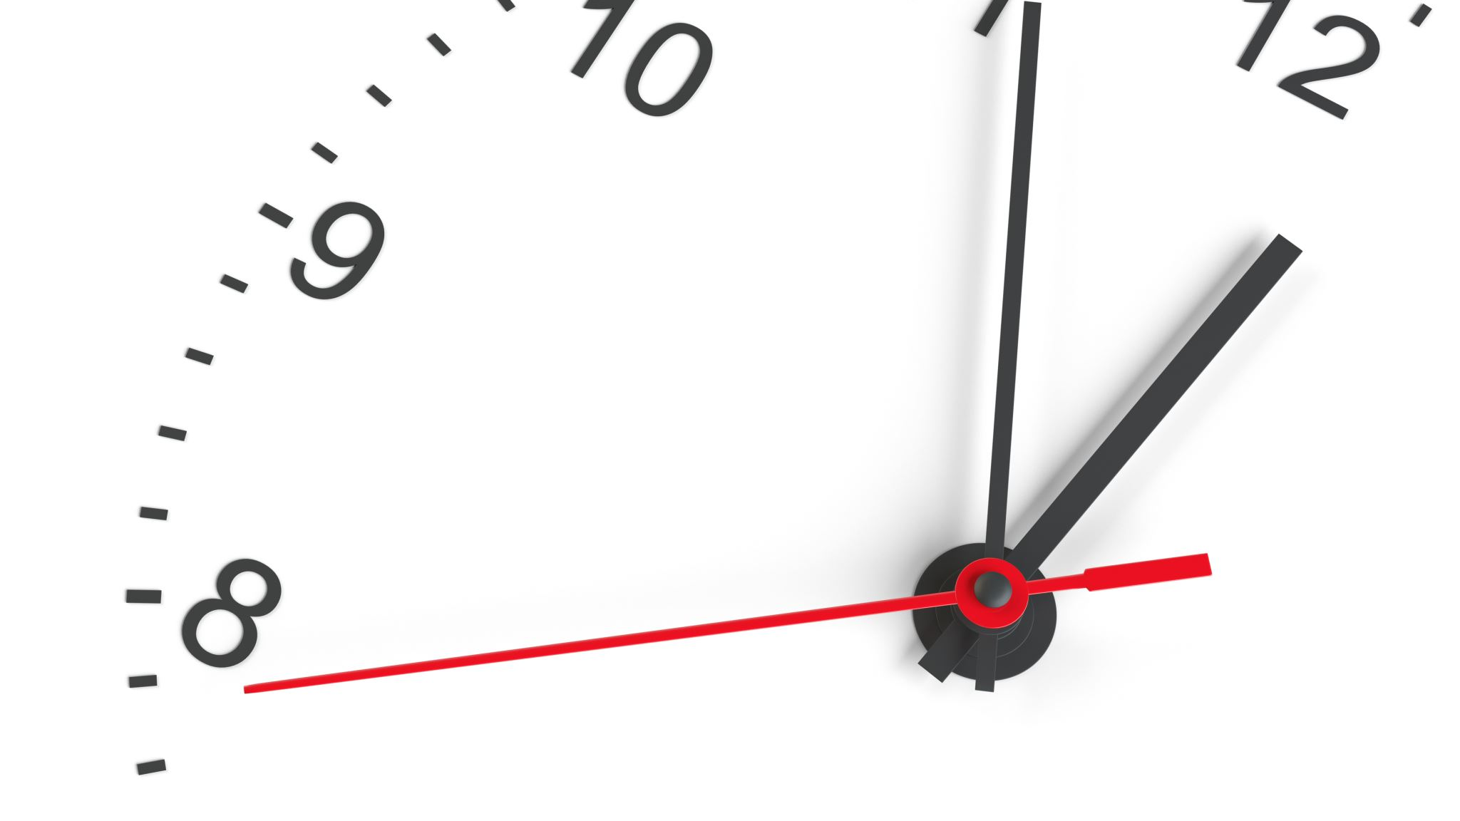
10 minute break

Slide 23
Widening Scope Responsibly
Notes:
Document
Consent from stakeholders
Verify space in budget & Resourcing

Slide 24
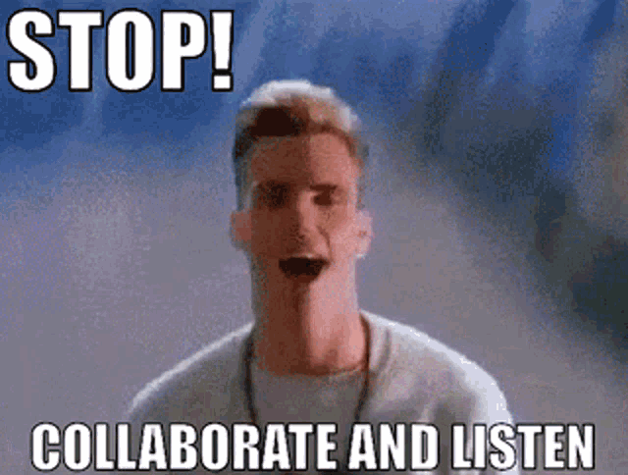
Vanilla Ice Says:
Notes:
If you find yourself in a situation where you need to consider widening scope, the best thing that you can do is to communicate with your peers in management both at the same level, and above you. Make sure that the needs are being met by either adding new items to the scope of the current project you are working on, or another option is to add scope elsewhere. There’s always going to be a balance of efficiency when something is asked to be added to the scope. When this happens, one of the first things that should be asked is, “is this something that actually needs to be done in the first place?” If it’s not, maybe it doesn’t need to be done at all.

Slide 25
Widening Scope Responsibly cont’
Be specific about what the new tasks aim to achieve
Ensure everyone knows an exception has been made
Document!

Slide 26

Managing Routine Work

Slide 27
Managing Task Workflow
Types of tasks:
Routine
Simple
Complex

Slide 28


Snow piles
Notes:
Think of task management like what happens the day after a heavy snow. Snow piles are the obvious routine tasks that need to be taken care of first. Some people use the metaphor “low-hanging fruit”. These tasks should be non-controversial and should require a minimal amount of deliberation to take care of. Like a snow pile in your hard, you know that you need to clear away things like your sidewalks and driveway before doing more complicated tasks.
These tasks are still work, but they’re considered more like maintenance than new feature work.

Slide 29

“Tech Debt”
Notes:
Every project has a certain amount of built-in “tech debt”. What this means is, as we add features, we will also be adding a certain amount of overhead to our project that we will be forced to maintain. Some features will add more tech debt than others especially if we are sloppy in our execution.
Say you’ve written a new feature in a language that handles the task we’ve put it to in a particularly inefficient way. Let’s say that the language we chose takes an extra 50 lines of code to implement than another language. By choosing the language we did, we will add debt to our project that we will eventually pay either in processing time and resources and complexity to maintain, or we can pay the debt in the time it will take to re-write the component with the more efficient language.

Slide 30
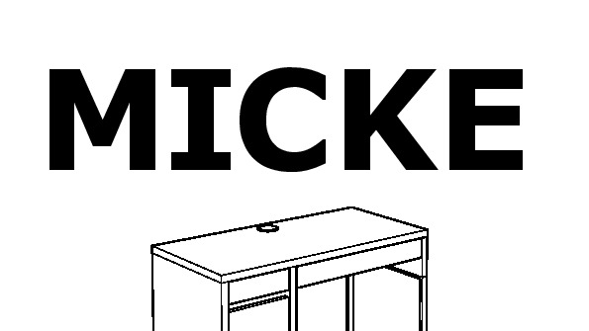
The Ikea Desk
Notes:
More complicated tasks with lots of little pieces. Involves some trial and error to figure out what tasks go where, or if they fit at all.

Slide 31
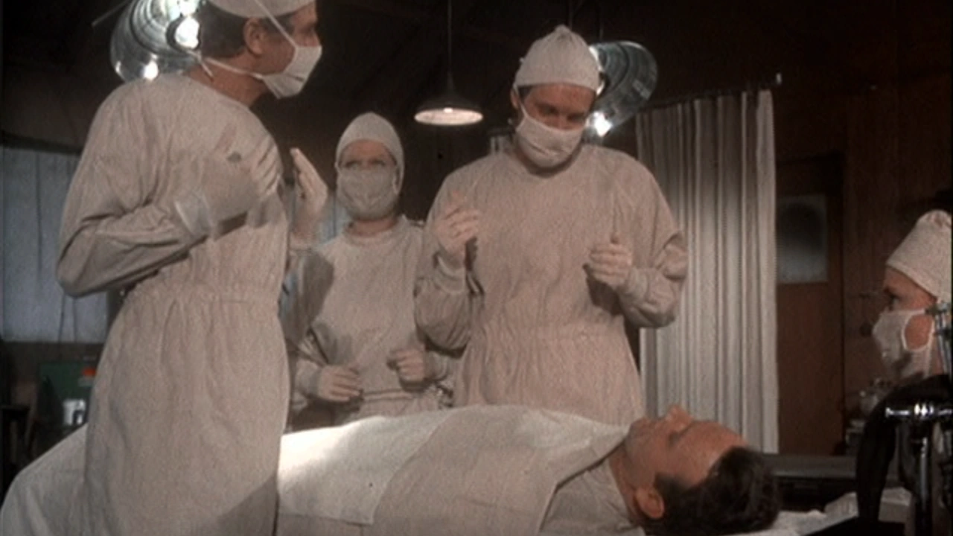
Heart Surgery
Notes:
Obviously, the most complicated, long-term tasks will be our heart surgery tasks. These things will probably noted on sprints and roadmaps. You might even need to task two or more contributors to work on these tasks.

Slide 32


Launch & Piloting

Slide 33

Phased Launch Approach

Slide 34
Phased Launch Approach Cont’
Accurate Planning
Simplified prioritization
Clearer team responsibilities
Transparent Progress tracking w/feature flags
Reduced scope creep

Slide 35
10 minute break

Slide 36
Phased Rollout Stakeholder Organizations
Developers
Management
Marketing
Support
Engineering
Notes:
When we go to do our rollout, we need to bring together multiple organizations which all need to work together for a successful product launch.

Slide 37
Phased Rollout
Test & Improve
Scale as you go
Build community of evangelists
Start marketing early
Build proof-points

Slide 38

Piloting

Slide 39

How does a product Pilot work?
What is a pilot?
Launching a smaller version of the end-product
Launched to a small group of users
We do this to learn things we didn’t know
Notes:
Using a pilot, we can learn about our product’s functionality at a smaller scale before we roll it out to a larger userbase.

Slide 40

Managing Human Biases

Slide 41
What is FUD?
Fear
Uncertainty
Doubt
Notes:
FUD comes in all forms, but the most detrimental forms for our purposes are around our decisions about what technology to use and how to use it.

Slide 42

On FUD and its effects

Slide 43

Managing Fear Uncertainty and Doubt
Notes:
Leadership!

Slide 44

The FUD Plague
Notes:
FUD has a way of spreading. Speak at length about this.

Slide 45

Sunk Cost

Slide 46

Benchmarking

Slide 47

What is Benchmarking?
Notes:
We can use benchmarking to identify problems. In prior sessions, we talked about how to identify the need to do a roll-back on content or released code. We also Making determinations about what

Slide 48

Metrics

Slide 49
Possible Metric Considerations
Key Performance Indicators (KPIs)
Statistics
Closed tickets
Commits & PRs
Income based measurement?

Slide 50
Structuring Quarterly
Benefits of structuring around quarterly goals:

Slide 51

Quiz time!
Notes:
At this point, you may take the remaining time we have in today’s class to sign onto the moodle and take the quiz.

Slide 52
Session Review

Slide 53

Question or clarifications?

Slide 54
Next Session PReview

Slide 55
See you next time!

